Slide 1
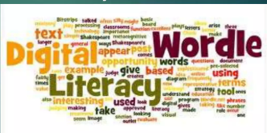
Digital literacy
Abdul Wahab (02-131222-132)
Abdullah Sadiq(02-131222-99)

Slide 2






What is Digital Literacy?

Slide 3
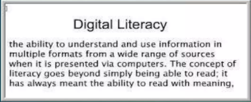

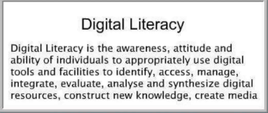

Slide 4
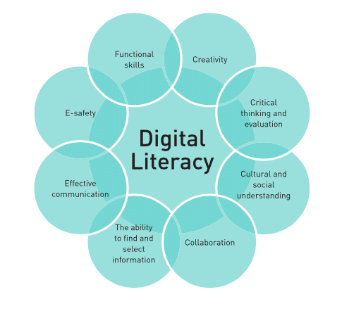
The Eight essential of digital Literacy

Slide 5

Why its improtant
Digital Literacy is an improtant topic because Technology is changing faster than society is.
Digital literacy can improve the academic performance of students by allowing them to create content such as presentations, videos and blog posts.

Slide 6
Information literacy
Determines the nature and extent of information needed.
Accesses the needed information effectively and efficiently.
Evaluation information and its Sources critically and incorporates selected information into his or her knowledge base and value system
Uses information effectively to accomplish a specific purpose.

Slide 7
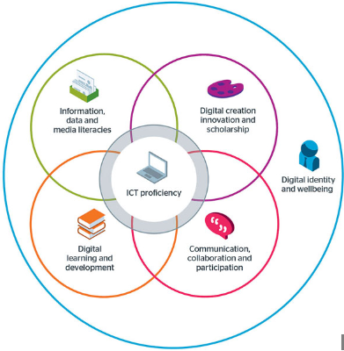
What it is.
Digital literacy means having the skills you need to live, learn, and work in a society where communication and access to information is increasingly through digital technologies like internet platforms, social media, and mobile devices. Developing your critical thinking skills.

